Slide 1
ANNOUNCEMENTS
today is Pre-Recoreded Lecture Monday ☹️
see you back in person on Wednesday!
WARMUP imagine searching for a tube of toothpaste in the real world
how would find one as quickly as possible?
TODAY
binary search trees

Slide 2
Week10a
✨No Laptop Monday! ✨
binary search
binary search trees
WARMUP
how long does it take to find (search for) something in...
- an array list?
- a linked list?
what if the list is sorted?

Slide 3
[record lecture]

Slide 4
review: sorted

Slide 5
sorted

Slide 6
sorted
a sequence is sorted if its elements are "in order"
by convention, this means ascending order (going up from left to right)
[1, 2, 5, 6, 9, 13] is sorted
[9, 5, 1, 2, 6, 13] is unsorted (NOT sored)

Slide 7
search

Slide 8
search
to search means to look for something (in some data structure)
a simple search problem is finding a given value in an array / list
// get index of the first element in array with this value // returns -1 if value not found int find(int[] array, int value) { ... }
// Option B class FindResult { boolean success; int index; } FindResult find(int[] array, int value) { ... }

Slide 9
linear search (of an array / array list)

Slide 10
linear search (brute force search)
linear search looks at each element one by one
linear search works whether or not the list is sorted
linear search is O(n) (linear time) 😐
// get index of the first element in array with this value // returns -1 if value not found int linearSearch(int[] array, int value) { for (int i = 0; i < array.length; ++i) { if (array[i] == value) { return i; } } return -1; }

Slide 11
example: linear search for 17 [13 2 55 7 17 100 77]

Slide 12
example: linear search for 17 [13 2 55 7 17 100 77]

Slide 13
example: linear search for 17 [13 2 55 7 17 100 77]

Slide 14
example: linear search for 17 [13 2 55 7 17 100 77]

Slide 15
example: linear search for 17 [13 2 55 7 17 100 77]

Slide 16
example: linear search for 17 [13 2 55 7 17 100 77]

Slide 17
example: linear search for 17 [13 2 55 7 17 100 77]

Slide 18
example: linear search for 17 [13 2 55 7 17 100 77]

Slide 19
example: linear search for 17 [13 2 55 7 17 100 77]

Slide 20
example: linear search for 17 [13 2 55 7 17 100 77]

Slide 21
example: linear search for 17 [13 2 55 7 17 100 77]

Slide 23
example: linear search for 17 [1 2 4 5 6 8 9 10 11 13 15 16 17 18 19]

Slide 24
example: linear search for 17 [1 2 4 5 6 8 9 10 11 13 15 16 17 18 19]

Slide 25
example: linear search for 17 [1 2 4 5 6 8 9 10 11 13 15 16 17 18 19]

Slide 26
example: linear search for 17 [1 2 4 5 6 8 9 10 11 13 15 16 17 18 19]

Slide 27
example: linear search for 17 [1 2 4 5 6 8 9 10 11 13 15 16 17 18 19]

Slide 28
example: linear search for 17 [1 2 4 5 6 8 9 10 11 13 15 16 17 18 19]

Slide 29
example: linear search for 17 [1 2 4 5 6 8 9 10 11 13 15 16 17 18 19]

Slide 30
example: linear search for 17 [1 2 4 5 6 8 9 10 11 13 15 16 17 18 19]

Slide 31
example: linear search for 17 [1 2 4 5 6 8 9 10 11 13 15 16 17 18 19]

Slide 32
example: linear search for 17 [1 2 4 5 6 8 9 10 11 13 15 16 17 18 19]

Slide 33
example: linear search for 17 [1 2 4 5 6 8 9 10 11 13 15 16 17 18 19]

Slide 34
example: linear search for 17 [1 2 4 5 6 8 9 10 11 13 15 16 17 18 19]

Slide 35
example: linear search for 17 [1 2 4 5 6 8 9 10 11 13 15 16 17 18 19]

Slide 36
example: linear search for 17 [1 2 4 5 6 8 9 10 11 13 15 16 17 18 19]

Slide 37
example: linear search for 17 [1 2 4 5 6 8 9 10 11 13 15 16 17 18 19]

Slide 38
example: linear search for 17 [1 2 4 5 6 8 9 10 11 13 15 16 17 18 19]

Slide 39
example: linear search for 17 [1 2 4 5 6 8 9 10 11 13 15 16 17 18 19]

Slide 40
example: linear search for 17 [1 2 4 5 6 8 9 10 11 13 15 16 17 18 19]

Slide 41
example: linear search for 17 [1 2 4 5 6 8 9 10 11 13 15 16 17 18 19]

Slide 42
example: linear search for 17 [1 2 4 5 6 8 9 10 11 13 15 16 17 18 19]

Slide 43
example: linear search for 17 [1 2 4 5 6 8 9 10 11 13 15 16 17 18 19]

Slide 44
example: linear search for 17 [1 2 4 5 6 8 9 10 11 13 15 16 17 18 19]

Slide 45
example: linear search for 17 [1 2 4 5 6 8 9 10 11 13 15 16 17 18 19]

Slide 46
example: linear search for 17 [1 2 4 5 6 8 9 10 11 13 15 16 17 18 19]

Slide 47
example: linear search for 17 [1 2 4 5 6 8 9 10 11 13 15 16 17 18 19]

Slide 48
example: linear search for 17 [1 2 4 5 6 8 9 10 11 13 15 16 17 18 19]

Slide 49
example: linear search for 17 [1 2 4 5 6 8 9 10 11 13 15 16 17 18 19]

Slide 50
if we know that an array is sorted... can we search it faster?

Slide 51
yes 🚀

Slide 52
unless it's a linked list 💀

Slide 53
binary search (of a array / array list)

Slide 54
binary search
binary search is an O(log n) algorithm for searching a sorted array 🙂
binary search works by "cutting the array in half" over and over
☠️ binary search only applies if the array is sorted

Slide 55
example: binary search for 17 [1 2 4 5 6 8 9 10 11 13 15 16 17 18 19]

Slide 56
example: binary search for 17 [1 2 4 5 6 8 9 10 11 13 15 16 17 18 19]
10 < 17

Slide 57
example: binary search for 17 [1 2 4 5 6 8 9 10 11 13 15 16 17 18 19]

Slide 58
example: binary search for 17 [1 2 4 5 6 8 9 10 11 13 15 16 17 18 19]
16 < 17

Slide 59
example: binary search for 17 [1 2 4 5 6 8 9 10 11 13 15 16 17 18 19]

Slide 60
example: binary search for 17 [1 2 4 5 6 8 9 10 11 13 15 16 17 18 19]
17 < 18

Slide 61
example: binary search for 17 [1 2 4 5 6 8 9 10 11 13 15 16 17 18 19]

Slide 62
example: binary search for 17 [1 2 4 5 6 8 9 10 11 13 15 16 17 18 19]
17 == 17

Slide 63
example: binary search for 17 [1 2 4 5 6 8 9 10 11 13 15 16 17 18 19]

Slide 64
☠️ implementating binary search is surprisingly tricky! make sure you test thoroughly!

Slide 65
✨ hint: binary search [1 2 4 5 6 8 9 10 11 13 15 16 17 18 19]
[^ 2 4 5 6 8 9 10 11 13 15 16 17 18 ^ ]
[| 2 4 5 6 8 9 10 11 13 15 16 17 18 | ]
[i = 0 4 5 6 8 9 10 11 13 15 16 17 18 j ]

Slide 66
review: binary tree

Slide 67
binary tree

Slide 68
binary tree
a binary tree is a tree in which each node has <= 2 children
10
5
16
2
13
18
1
4
11
15
17

Slide 69
🧠 can a linked list be seen as a binary tree?

Slide 70
technically, yes (assuming no cycles) all nodes have <= 2 children (tail has 0 children, all other nodes have 1 child)

Slide 71
ordered binary tree

Slide 72
(ordered) binary tree
each node has a left child and a right child (either or both children can be null)
10
5
16
node
13
18
11
15
17
node.leftChild
node.rightChild

Slide 73
(ordered) binary tree
each node has a left subtree and a right subtree (and left descendants and right descendants)

Slide 74
binary search tree

Slide 75
binary search tree

Slide 76
binary search tree
in a binary search tree (BST, sorted binary tree) every node follows: "a node's value is greater than the values of all nodes in its left subtree and less than the values of all nodes in its right subtree"
10
5
16
2
13
18
1
4
11
15
17

Slide 77
binary search tree
in a binary search tree (BST, sorted binary tree) every node follows: "a node's value is greater than the values of all nodes in its left subtree and less than the values of all nodes in its right subtree"
10
10 < 16
5
16
5 < 10
2 < 10
10 < 13
2
13
18
10 < 18
1
4
10 < 11
11
15
17
10 < 17
4 < 10
1 < 10
10 < 15

Slide 78
binary search tree
in a binary search tree (BST, sorted binary tree) every node follows: "a node's value is greater than the values of all nodes in its left subtree and less than the values of all nodes in its right subtree"
10
5
16
13 < 16
2
13
18
16 < 18
1
4
11 < 16
11
15
17
16 < 17
15 < 16

Slide 79
binary search tree
in a binary search tree (BST, sorted binary tree) every node follows: "a node's value is greater than the values of all nodes in its left subtree and less than the values of all nodes in its right subtree"
10
5
16
2
13
18
1
4
11
15
17

Slide 80
is it a BST?

Slide 81
2
4
1
3
6
Is It A Binary Search Tree?
4
9
3
5
in a binary search tree (sorted binary tree) every node follows: "a node's value is greater than the values of all nodes in its left subtree and less than the values of all nodes in its right subtree"
2
1
10
5
16
2
8
13
18
1
4
6
9
14
15
17
19

Slide 82
2
4
1
3
6
4
9
3
5
in a binary search tree (sorted binary tree) every node follows: "a node's value is greater than the values of all nodes in its left subtree and less than the values of all nodes in its right subtree"
2
1
10
5
16
2
8
13
18
1
4
6
9
14
15
17
19

Slide 83
binary search (of a binary search tree)

Slide 84
binary search
binary search "cuts a BST in half" over and over
binary search only works when the binary tree is sorted (is a binary search tree)
binary search is O(log n) if the tree is "balanced" 🙂
balanced means each node's children are similar in height (intuitive understanding of this is sufficient; will discuss more on Fri)
10
10
5
16
5
2
8
13
18
2
1
6
9
11
9
1
balanced
NOT balanced

Slide 85
example: binary search for 17 [1 2 4 5 6 8 9 10 11 13 15 16 17 18 19]
10
5
16
2
8
13
18
1
4
6
9
11
15
17
19

Slide 86
example: binary search for 17 [1 2 4 5 6 8 9 10 11 13 15 16 17 18 19]
10
10 < 17
5
16
2
8
13
18
1
4
6
9
11
15
17
19

Slide 87
example: binary search for 17 [1 2 4 5 6 8 9 10 11 13 15 16 17 18 19]
10
5
16
2
8
13
18
1
4
6
9
11
15
17
19

Slide 88
example: binary search for 17 [1 2 4 5 6 8 9 10 11 13 15 16 17 18 19]
10
5
16
16 < 17
2
8
13
18
1
4
6
9
11
15
17
19

Slide 89
example: binary search for 17 [1 2 4 5 6 8 9 10 11 13 15 16 17 18 19]
10
5
16
2
8
13
18
1
4
6
9
11
15
17
19

Slide 90
example: binary search for 17 [1 2 4 5 6 8 9 10 11 13 15 16 17 18 19]
10
5
16
2
8
13
18
17 < 18
1
4
6
9
11
15
17
19

Slide 91
example: binary search for 17 [1 2 4 5 6 8 9 10 11 13 15 16 17 18 19]
10
5
16
2
8
13
18
1
4
6
9
11
15
17
19

Slide 92
example: binary search for 17 [1 2 4 5 6 8 9 10 11 13 15 16 17 18 19]
10
5
16
2
8
13
18
1
4
6
9
11
15
17
19
17 == 17

Slide 93
example: binary search for 17 [1 2 4 5 6 8 9 10 11 13 15 16 17 18 19]
10
5
16
2
8
13
18
1
4
6
9
11
15
17
19

Slide 94
note: a binary search tree is NOT unique let's look at another BST for the same data!

Slide 95
example: binary search for 17 [1 2 4 5 6 8 9 10 11 13 15 16 17 18 19]
2
1
4
5
6
8
9
10
11
13
15
16
17
18
19

Slide 96
example: binary search for 17 [1 2 4 5 6 8 9 10 11 13 15 16 17 18 19]
2
1
4
5
6
8
9
10
11
13
15
16
17
18
19

Slide 97
example: binary search for 17 [1 2 4 5 6 8 9 10 11 13 15 16 17 18 19]
2
1
4
5
6
8
9
10
11
13
15
16
17
18
19

Slide 98
example: binary search for 17 [1 2 4 5 6 8 9 10 11 13 15 16 17 18 19]
2
1
4
5
6
8
9
10
11
13
15
16
17
18
19

Slide 99
example: binary search for 17 [1 2 4 5 6 8 9 10 11 13 15 16 17 18 19]
2
1
4
5
6
8
9
10
11
13
15
16
17
18
19

Slide 100
example: binary search for 17 [1 2 4 5 6 8 9 10 11 13 15 16 17 18 19]
2
1
4
5
6
8
9
10
11
13
15
16
17
18
19

Slide 101
example: binary search for 17 [1 2 4 5 6 8 9 10 11 13 15 16 17 18 19]
2
1
4
5
6
8
9
10
11
13
15
16
17
18
19

Slide 102
example: binary search for 17 [1 2 4 5 6 8 9 10 11 13 15 16 17 18 19]
2
1
4
5
6
8
9
10
11
13
15
16
17
18
19

Slide 103
example: binary search for 17 [1 2 4 5 6 8 9 10 11 13 15 16 17 18 19]
2
1
4
5
6
8
9
10
11
13
15
16
17
18
19

Slide 104
...

Slide 105
life lesson: it is important that your binary search tree is ✨balanced✨ (otherwise your "binary search" degrades into linear search of a linked list ☹️)

Slide 106
adding a new node to a binary search tree (the naive (simple but bad) method)

Slide 107
for a binary search tree, add starts out just like search

Slide 108
just keep going until you hit a null node put the new node there 🙂👍

Slide 109
example: adding 7
10
5
16
2
8
13
18
1
4
6
9
11
15
17
19

Slide 110
example: adding 7
10
5
16
2
8
13
18
1
4
6
9
11
15
17
19

Slide 111
example: adding 7
10
5
16
2
8
13
18
1
4
6
9
11
15
17
19

Slide 112
example: adding 7
10
5
16
2
8
13
18
1
4
6
9
11
15
17
19

Slide 113
example: adding 7
10
5
16
2
8
13
18
1
4
6
9
11
15
17
19

Slide 114
example: adding 7
10
5
16
2
8
13
18
1
4
6
9
11
15
17
19
null

Slide 115
example: adding 7
10
5
16
2
8
13
18
1
4
6
9
11
15
17
19
7

Slide 116
example: adding 7
10
5
16
2
8
13
18
1
4
6
9
11
15
17
19
7

Slide 117
is this approach to adding a new node good? hint: no.

Slide 118
self-balancing binary search trees note: hard to implement

Slide 119


Slide 120
uses of binary search trees

Slide 121
tree map (implement a map)
you can implement the map interface using a BST NOTE: this is NOT a hash map!—no hashing is involved!
class Node {
String key; // NOTE: BST is sorted by key
Integer value;
Node leftChild;
Node rightChild;
}
class TreeMap { Node root;
ValueType get(KeyType) { ... }
void put(ValueType, KeyType) { ... }
}
"Ditto"
132
"Arbok"
24
"Mew"
151

Slide 122
binary tree depth-first traversal orders

Slide 123
binary tree depth-first traversal orders

Slide 124
depth-first traversal orders (of a binary tree)
pre-order = self, left, right
3, 1, 0, 2, 5, 4, 6
in-order = left, self, right
0, 1, 2, 3, 4, 5, 6
post-order = left, right, self
0, 2, 1, 4, 6, 5, 3
reverse pre-order = self, right, left
3, 5, 6, 4, 1, 2, 0
reverse in-order = right, self, left
6, 5, 4, 3, 2, 1, 0
reverse post-order = right, left, self
6, 4, 5, 2, 0, 1, 3
3
1
5
0
2
4
6

Slide 125

2 * 3
+ 4
who's that
traversal order?
+
in-order!
*
4
2
3

Slide 126
void recurse(Node self) {
// NOTE: rearranging these 3 lines gives you all
// 3! ("three factorial") = 6 traversal orders
if (self.leftChild != null) { recurse(self.leftChild); }
System.out.print(self.value + " ");
if (self.rightChild != null) { recurse(self.rightChild); }
}

Slide 127
ANNOUNCEMENTS
today is See You Back In Person on Wednesday Wednesday!
WARMUP Is It A Binary Search Tree?
TODAY
traversal order demo; heaps
2
4
1
3
6
4
9
3
5
in a binary search tree (sorted binary tree) every node follows: "a node's value is greater than the values of all nodes in its left subtree and less than the values of all nodes in its right subtree"
2
1
10
5
16
2
8
13
18
1
4
6
9
14
15
17
19

Slide 128
ANNOUNCEMENTS
today is See You Back In Person on Wednesday Wednesday!
WARMUP Is It A Binary Search Tree?
TODAY
traversal order demo; heaps
2
4
1
3
6
4
9
3
5
in a binary search tree (sorted binary tree) every node follows: "a node's value is greater than the values of all nodes in its left subtree and less than the values of all nodes in its right subtree"
2
1
10
5
16
2
8
13
18
1
4
6
9
14
15
17
19

Slide 129
record LEC-02

Slide 130
something to ponder: what will this pseducode do? binarySearchTree = BinarySearchTree() array = [ 1, 2, 5, 6, 7, 9, 12, 17 ] for element in array: binarySearchTree.add(element)

Slide 131
TODO (Jim): Live-code traversal orders (Feel free to follow along or race.)

Slide 132
heaps

Slide 133
always-complete max binary heap

Slide 134
always-complete max binary heap
in this class, when we say "heap" or "max heap", we mean an "always-complete max binary heap"
we might occasionally mention a "min heap", which means an "always-complete min binary heap"

Slide 135
always-complete max binary heap
in a complete binary tree, all levels (depths, rows) are "full of nodes", except for possibly the bottom level, in which all nodes are "as far to to the left as possible"
10
10
5
16
5
16
2
8
13
18
2
8
13
18
1
4
6
9
11
1
4
6
11
complete
(and balanced)
balanced but NOT complete

Slide 136
always-complete max binary heap
in a complete binary tree, all levels (depths) are "full of nodes", except for possibly the bottom level, in which all nodes are "as far to to the left as possible"
10
5
16
2
8
13
18
1
4
6
9
the "last node"
complete
(and balanced)

Slide 137
always-complete max binary heap
"always-complete" means that every function in the Heap interface (add(...) & remove()) "preserves the completeness of the heap"
the heap was complete before calling add...
...and the heap is still complete after add returns

Slide 138
always-complete max binary heap
a binary heap is another special kind of binary tree
☠️ a binary heap is NOT, in general, a binary search tree

Slide 139
always-complete max binary heap
in a max binary heap, every node follows: "a node's value is greater than the value of its left child and the value of its right child"
27
15
5
7
13
4
2
6
3
11
12
1

Slide 140
always-complete max binary heap
in a max binary heap, every node follows: "a node's value is greater than the value of its left child and the value of its right child"
27
27 > 15
27 > 5
15
5
7
13
4
2
6
3
11
12
1

Slide 141
always-complete max binary heap
in a max binary heap, every node follows: "a node's value is greater than the value of its left child and the value of its right child"
27
15
5
7
13
4
2
6
3
11
12
1
7 > 6
7 > 3

Slide 142
always-complete max binary heap
in a max binary heap, every node follows: "a node's value is greater than the value of its left child and the value of its right child"
🧠 is the "max heap property" above equivalent to...
in a max binary heap, every node follows: "a node's value is greater than the values of all its descendants"
yes.
idea: apply definition recursively
node's value is greater than the values of its children... ...which are greater than the values of their children...
🧠 which node always has the max value of all nodes in the heap?
the root

Slide 143
always-complete max binary heap
in a max binary heap, every node follows: "a node's value is greater than the values of all its descendants"
27
15
5
15 > 7
7
15 > 13
13
4
2
6
3
11
12
1
15 > 6
15 > 3
15 > 11
15 > 12

Slide 144
heap interface add(...) & remove() 🐡 ⚓️

Slide 145
heap interface
// Add this value to the heap. void add(ValueType value) { ... }
// Remove the max value from the heap, and return it. ValueType remove() { ... }

Slide 146
add(...)

Slide 147
void add(ValueType value);
to add a new node with a given value to a max binary heap...
add the new node so that the heap is still complete (add into "the next empty slot")
while that node violates the max heap property...
swap it with its parent
the node "swims up" 🐡
"sifts up"
"heap up"?

Slide 148
example: adding 10
27
15
5
7
13
4
2
6
3
11
12
1

Slide 149
example: adding 10
27
15
5
7
13
4
2
6
3
11
12
1

Slide 150
example: adding 10
27
15
5
7
13
4
2
6
3
11
12
1
10

Slide 151
example: adding 10
27
15
5
7
13
4
2
6
3
11
12
1
10

Slide 152
example: adding 10
27
15
5
7
13
4
2
6
3
11
12
1
10

Slide 153
example: adding 10
27
15
5
7
13
10
2
6
3
11
12
1
4

Slide 154
example: adding 10
27
15
5
7
13
10
2
6
3
11
12
1
4

Slide 155
example: adding 10
27
15
5
7
13
10
2
6
3
11
12
1
4

Slide 156
example: adding 10
27
15
5
7
13
10
2
6
3
11
12
1
4

Slide 157
example: adding 10
27
15
10
7
13
5
2
6
3
11
12
1
4

Slide 158
example: adding 10
27
15
10
7
13
5
2
6
3
11
12
1
4

Slide 159
example: adding 10
27
15
10
7
13
5
2
6
3
11
12
1
4

Slide 160
example: adding 10
27
15
10
7
13
5
2
6
3
11
12
1
4

Slide 161
example: adding 10
27
15
10
7
13
5
2
6
3
11
12
1
4

Slide 162
remove()

Slide 163
ValueType remove();
to remove the node with max value (the root) from a max binary heap...
save the root's value in a temporary variable called result
replace the root with the last node (rightmost node in the bottom level) (the old root is now "dead" and ready to be garbage collected 🚛)
while that node violates the max heap property...
swap it with its larger child
return result;
the node "sinks down" ⚓️
"sifts down"
"heap down"?

Slide 164
example: removing max node
27
15
5
7
13
4
2
6
3
11
0
1

Slide 165
example: removing max node
int result = root.value;
27
15
5
7
13
4
2
6
3
11
0
1

Slide 166
example: removing max node
27
15
5
7
13
4
2
6
3
11
0
1

Slide 167
example: removing max node
27
15
5
7
13
4
2
6
3
11
0
1

Slide 168
example: removing max node
1
15
5
7
13
4
2
6
3
11
0

Slide 169
example: removing max node
1
15
5
7
13
4
2
6
3
11
0

Slide 170
example: removing max node
1
15
5
7
13
4
2
6
3
11
0

Slide 171
example: removing max node
1
15
5
7
13
4
2
6
3
11
0

Slide 172
example: removing max node
15
1
5
7
13
4
2
6
3
11
0

Slide 173
example: removing max node
15
1
5
7
13
4
2
6
3
11
0

Slide 174
example: removing max node
15
1
5
7
13
4
2
6
3
11
0

Slide 175
example: removing max node
15
1
5
7
13
4
2
6
3
11
0

Slide 176
example: removing max node
15
1
5
7
13
4
2
6
3
11
0

Slide 177
example: removing max node
15
13
5
7
1
4
2
6
3
11
0

Slide 178
example: removing max node
15
13
5
7
1
4
2
6
3
11
0

Slide 179
example: removing max node
15
13
5
7
1
4
2
6
3
11
0

Slide 180
example: removing max node
15
13
5
7
1
4
2
6
3
11
0

Slide 181
example: removing max node
15
13
5
7
11
4
2
6
3
1
0

Slide 182
example: removing max node
15
13
5
7
11
4
2
6
3
1
0

Slide 183
example: removing max node
15
13
5
7
11
4
2
6
3
1
0

Slide 184
example: removing max node
15
13
5
7
11
4
2
6
3
1
0

Slide 185
example: removing max node
15
13
5
7
11
4
2
6
3
1
0
return result;

Slide 186
ANNOUNCEMENTS today is Fun Friday with DJ Microsoft Excel
also Prof. Katie Keith is Visiting Friday WARMUP How tall is a perfect (totally full) binary tree with n nodes? Give your answer in big O. Is it O(1), O(log n), O(n), O(n²), ...?
TODAY binary search tree and heap wrap-up
10
10
10
10
10
10
10
5
16
5
16
5
16
5
16
2
8
13
18
2
8
13
18
2
8
13
18
2
8
13
18
1
4
6
9
14
15
17
19
1
4
6
9
14
15
17
19
1
4
6
9
14
15
17
19
1
4
6
9
14
15
17
19

Slide 187
record LEC-02

Slide 188
1 node → height 0
1

Slide 189
3 nodes → height 1
2
1
4

Slide 190
7 nodes → height 2
5
2
8
1
4
6
9

Slide 191
15 nodes → height 3
10
5
16
2
8
13
18
1
4
6
9
14
15
17
19

Slide 192
31 nodes → height 4
10
10
10
5
16
5
16
2
8
13
18
2
8
13
18
1
4
6
9
14
15
17
19
1
4
6
9
14
15
17
19

Slide 193
63 nodes → height 5
10
10
10
10
10
10
10
5
16
5
16
5
16
5
16
2
8
13
18
2
8
13
18
2
8
13
18
2
8
13
18
1
4
6
9
14
15
17
19
1
4
6
9
14
15
17
19
1
4
6
9
14
15
17
19
1
4
6
9
14
15
17
19

Slide 194
summary
(1 node, height 0)
(3 nodes, height 1)
(7 nodes, height 2)
(15 nodes, height 3)
(31 nodes, height 4)
(63 nodes, height 5)
...

Slide 195
summary
(1, 0)
(3, 1)
(7, 2)
(15, 3)
(31, 4)
(63, 5)
...

Slide 196
summary
1 | 0
3 | 1
7 | 2
15 | 3
31 | 4
63 | 5

Slide 197
TODO (Jim): Let's make a plot.

Slide 198
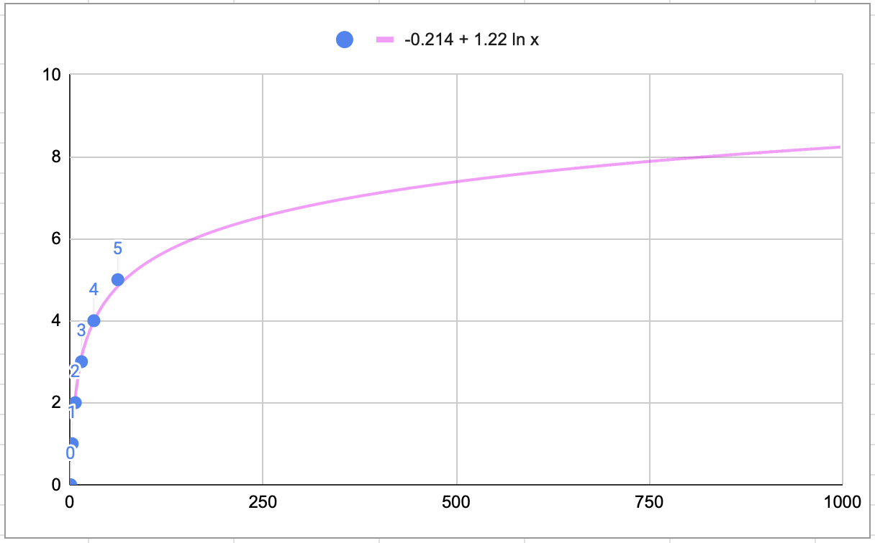
tree height
num nodes

Slide 199
log n

Slide 200
a balanced binary tree has O(log n) height note: the example we just did showed this for a "perfectly balanced" binary tree, but it is also true for just plain ol' balanced binary search trees

Slide 201
implications: searching a binary search tree is O(log n)

Slide 202
what does log look like?

Slide 203
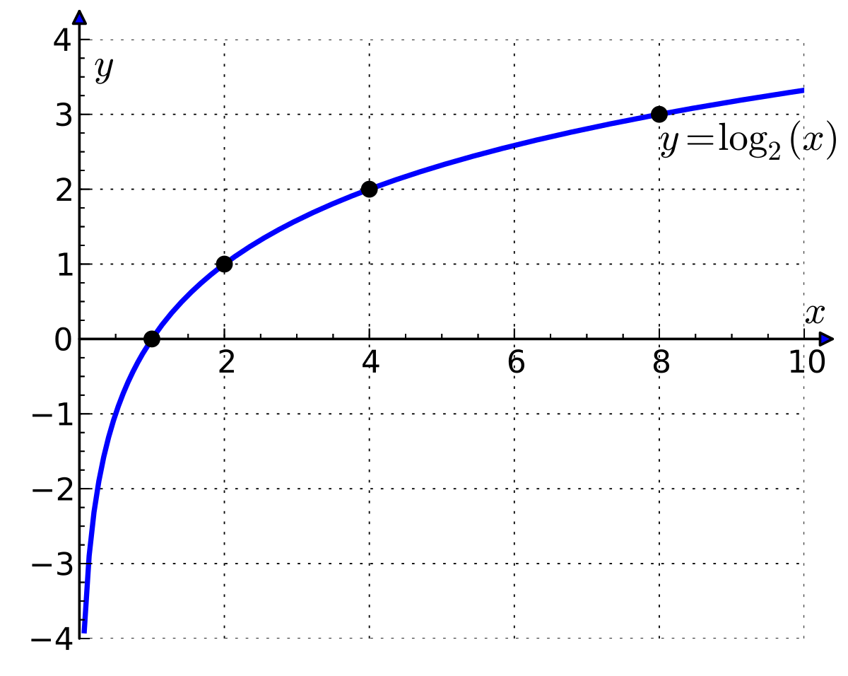

Slide 204
log is the inverse of exponential growth

Slide 205
y = 2^{x}
🧠 solve for x.

Slide 206
y = 2^{x} x = log₂ y

Slide 207
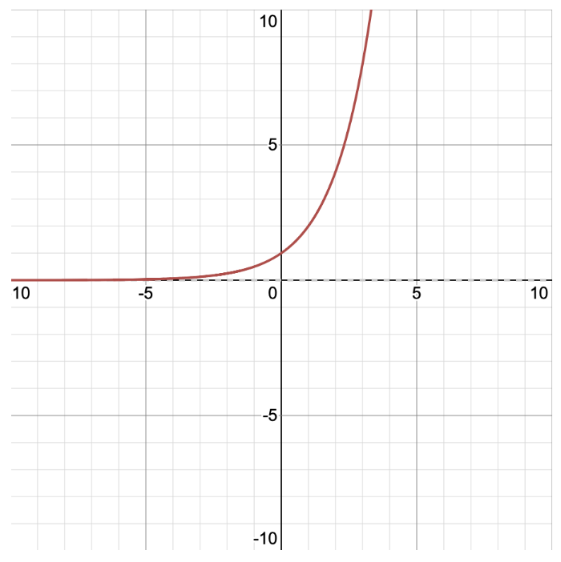
y = 2^{x} x = log₂ y
y
x

Slide 208
y = 2^{x} x = log₂ y
y
x

Slide 209
the change of base formula implies that O(log₂ n) = O(log₁₀ n) = ...

Slide 210
log_{b} n = log_{d} n / log_{d} b

Slide 211
log₂ n = log₁₀ n / log₁₀ 2

Slide 212
log₂ n = log₁₀ n / log₁₀ 2
this is a constant.

Slide 213
log₂ n = c log₁₀ n

Slide 214
O(log₂ n) = O(c log₁₀ n)

Slide 215
O(log₂ n) = O(log₁₀ n)

Slide 216
O(log₂ n) and O(log₁₀ n) are the exact same thing

Slide 217
so you can just say O(log n) and not worry about it 🙂👍

Slide 218
binary search tree details

Slide 219
self-balancing binary search trees

Slide 220
life lesson: it is important that your binary search tree is ✨balanced✨ (otherwise things starts to look a lot like linear search on a linked list ☹️)

Slide 221


Slide 222
self-balancing binary search trees are very cool but painful to implement

Slide 223
heap details

Slide 224
heap application: priority queue

Slide 225

review: queue
remove();

Slide 226
review: queue
remove();

Slide 227
review: queue
add();

Slide 228
review: queue
add();

Slide 229
review: queue
remove();

Slide 230
review: queue

Slide 231
extension: priority queue

Slide 232

extension: priority queue

Slide 233

extension: priority queue
priority 1

Slide 234

extension: priority queue
priority 1
priority 1

Slide 235

extension: priority queue
priority 9
priority 1
priority 1

Slide 236

extension: priority queue
priority 9
priority 1
priority 1
priority 5

Slide 237

extension: priority queue
priority 999
priority 9
priority 1
priority 1
priority 5

Slide 238
extension: priority queue
priority 999
priority 9
priority 1
priority 1
priority 5

Slide 239
a heap's remove() function removes the node with maximum value

Slide 240
a priority queue's remove() function removes the element with highest priority

Slide 241
TODO: club penguin meme

Slide 242
heap application: (implicit) heapsort

Slide 243

because a heap is an always-complete binary tree, we can store a heap "implicitly" as an array using a breadth-first (level-order) traversal!
[ 9 8 7 6 4 1 2 3 5 ]
9
8
7
6
4
1
2
3
5

Slide 244
this lets us do in-place heapsort! (using only swaps)

Slide 245
1. build a heap by calling add(...) over and over 2. deconstruct the heap by calling remove() over and over

Slide 246
[ 7 3 2 4 6 1 8 5 9 ]

Slide 247
[ 7 3 2 4 6 1 8 5 9 ]
7

Slide 248
[ 7 3 2 4 6 1 8 5 9 ]
7
3

Slide 249
[ 7 3 2 4 6 1 8 5 9 ]
7
3
2

Slide 250
[ 7 3 2 4 6 1 8 5 9 ]
7
3
2
🐡
4

Slide 251
[ 7 4 2 3 6 1 8 5 9 ]
7
💦
4
2
3

Slide 252
[ 7 4 2 3 6 1 8 5 9 ]
7
4
2
3

Slide 253
[ 7 4 2 3 6 1 8 5 9 ]
7
4
2
🐡
3
6

Slide 254
[ 7 6 2 3 4 1 8 5 9 ]
7
6
💦
2
3
4

Slide 255
[ 7 6 2 3 4 1 8 5 9 ]
7
6
2
3
4

Slide 256
[ 7 6 2 3 4 1 8 5 9 ]
7
6
2
3
4
1

Slide 257
[ 7 6 2 3 4 1 8 5 9 ]
7
6
2
🐡
3
4
1
8

Slide 258
[ 7 6 8 3 4 1 2 5 9 ]
7
🐡
6
8
3
4
1
2

Slide 259
[ 8 6 7 3 4 1 2 5 9 ]
8
💦
6
7
3
4
1
2

Slide 260
[ 8 6 7 3 4 1 2 5 9 ]
8
6
7
3
4
1
2

Slide 261
[ 8 6 7 3 4 1 2 5 9 ]
8
6
7
3
4
1
2
🐡
5

Slide 262
[ 8 6 7 5 4 1 2 3 9 ]
8
6
7
💦
5
4
1
2
3

Slide 263
[ 8 6 7 5 4 1 2 3 9 ]
8
6
7
5
4
1
2
3

Slide 264
[ 8 6 7 5 4 1 2 3 9 ]
8
6
7
5
4
1
2
🐡
3
9

Slide 265
[ 8 6 7 9 4 1 2 3 5 ]
8
6
7
🐡
9
4
1
2
3
5

Slide 266
[ 8 9 7 6 4 1 2 3 5 ]
8
🐡
9
7
6
4
1
2
3
5

Slide 267
[ 9 8 7 6 4 1 2 3 5 ]
💦
9
8
7
6
4
1
2
3
5

Slide 268
[ 9 8 7 6 4 1 2 3 5 ]
9
8
7
6
4
1
2
3
5

Slide 269
[ 9 8 7 6 4 1 2 3 5 ]
9
8
7
6
4
1
2
3
5

Slide 270
[ 5 8 7 6 4 1 2 3 9 ]
⚓️
5
8
7
6
4
1
2
3

Slide 271
[ 8 5 7 6 4 1 2 3 9 ]
8
⚓️
5
7
6
4
1
2
3

Slide 272
[ 8 6 7 5 4 1 2 3 9 ]
8
6
7
💦
5
4
1
2
3

Slide 273
[ 8 6 7 5 4 1 2 3 9 ]
8
6
7
5
4
1
2
3

Slide 274
[ 8 6 7 5 4 1 2 3 9 ]
8
6
7
5
4
1
2
3

Slide 275
[ 3 6 7 5 4 1 2 8 9 ]
3
⚓️
6
7
5
4
1
2

Slide 276
[ 7 6 3 5 4 1 2 8 9 ]
7
💦
6
3
5
4
1
2

Slide 277
[ 7 6 3 5 4 1 2 8 9 ]
7
6
3
5
4
1
2

Slide 278
[ 7 6 3 5 4 1 2 8 9 ]
7
6
3
5
4
1
2

Slide 279
[ 2 6 3 5 4 1 7 8 9 ]
⚓️
2
6
3
5
4
1

Slide 280
[ 6 2 3 5 4 1 7 8 9 ]
6
⚓️
2
3
5
4
1

Slide 281
[ 6 5 3 2 4 1 7 8 9 ]
6
5
3
💦
2
4
1

Slide 282
[ 6 5 3 2 4 1 7 8 9 ]
6
5
3
2
4
1

Slide 283
[ 6 5 3 2 4 1 7 8 9 ]
6
5
3
2
4
1

Slide 284
[ 1 5 3 2 4 6 7 8 9 ]
⚓️
1
5
3
2
4

Slide 285
[ 5 1 3 2 4 6 7 8 9 ]
5
1
⚓️
3
2
4

Slide 286
[ 5 4 3 2 1 6 7 8 9 ]
5
4
3
💦
2
1

Slide 287
[ 5 4 3 2 1 6 7 8 9 ]
5
4
3
2
1

Slide 288
[ 5 4 3 2 1 6 7 8 9 ]
5
4
3
2
1

Slide 289
[ 1 4 3 2 5 6 7 8 9 ]
⚓️
1
4
3
2

Slide 290
[ 4 1 3 2 5 6 7 8 9 ]
4
⚓️
1
3
2

Slide 291
[ 4 2 3 1 5 6 7 8 9 ]
4
2
3
💦
1

Slide 292
[ 4 2 3 1 5 6 7 8 9 ]
4
2
3
1

Slide 293
[ 4 2 3 1 5 6 7 8 9 ]
4
2
3
1

Slide 294
[ 1 2 3 4 5 6 7 8 9 ]
1
⚓️
2
3

Slide 295
[ 3 2 1 4 5 6 7 8 9 ]
3
💦
2
1

Slide 296
[ 3 2 1 4 5 6 7 8 9 ]
3
2
1

Slide 297
[ 3 2 1 4 5 6 7 8 9 ]
3
2
1

Slide 298
[ 1 2 3 4 5 6 7 8 9 ]
⚓️
1
2

Slide 299
[ 2 1 3 4 5 6 7 8 9 ]
2
💦
1

Slide 300
[ 2 1 3 4 5 6 7 8 9 ]
2
1

Slide 301
[ 2 1 3 4 5 6 7 8 9 ]
2
1

Slide 302
[ 1 2 3 4 5 6 7 8 9 ]
1

Slide 303
[ 1 2 3 4 5 6 7 8 9 ]
1

Slide 304
[ 1 2 3 4 5 6 7 8 9 ]
1

Slide 305
[ 1 2 3 4 5 6 7 8 9 ]

Slide 306
gamedev update (switch to other laptop)

Slide 307
avl tree red black tree anchor n vs. log n priority queue (club analogy) log(n) time implicit heap robots/games

Slide 308
space complexity

Slide 309
john's robots tree algorithm

Slide 310
Week08a
ANNOUNCEMENTS today is No Laptop Monday!
WARMUP "a chain is only as strong as its weakest link"
- what does this expression mean?
- what is a chain?
- what is a link?
- is this true for real-world metal chains? why or why not?
TODAY linked lists
🦜🦜🦜🦜🦜🦜🦜🦜

Slide 311


Slide 312


Slide 313
linked lists
record lecture

Slide 314
(p)review: list interface

Slide 315
list interface
// Get the element with this index.
ElementType get(int index);
// Add (append) an element to the back of the list. void add();
// Add (insert) an element into the list so it has this index void add(int index, ElementType element);
// Remove (delete) the element in the list at this index. void remove(int index);
// Get the number of elements currently in the list. int size();

Slide 316
list interface (cont.)
// NOTE: Many other functions could be included // in this interface.
void sort(); // Sort the list.
void reverse(); // Reverse the list.
List<ElementType> sorted(); // Get sorted copy of the list.
List<ElementType> reversed(); // Get reversed copy of list.
// Get index of first element with this value. int find(ElementType element);
...

Slide 317
a few weeks ago, we implemented the list interface using an array the array list

Slide 318
this week, we will implement the list interface using nodes with "links" (references) to other nodes this will be called a linked list

Slide 319
note

Slide 320
today we will be discussing the simplest possible linked list (LinkedList literally just has a reference to Node head.)

Slide 321
🐍
3.0
head
|
|
head.next
|
|
|
|
|
null

Slide 322
some other implementations are possible. some will be faster than this one.

Slide 323
for linked lists, do NOT memorize big O runtimes out of context

Slide 324
why are we doing this?

Slide 325
A: it will be cool to see two very different implementations of the same interface ☃️

Slide 326
B: linked lists will prepare us for trees and graphs🌳

Slide 327
C: linked lists are incredibly FUNdaMENTAL 🥳 (for us, as fundamental as arrays)

Slide 328
D: linked lists are actually big O better (than array lists) in very specific cases

Slide 329
E: linked lists are actually really, really important (especially in the C programming language)

Slide 330
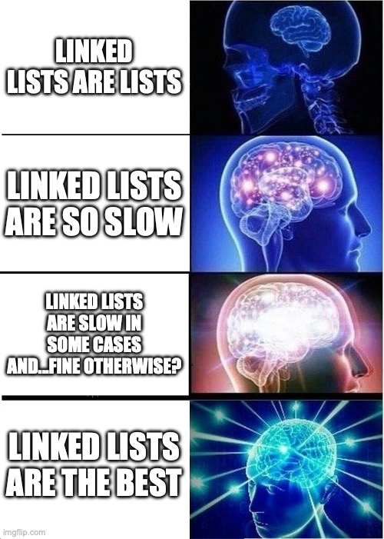

Slide 331
linked list

Slide 333
1.0
2.0
3.0

Slide 334
3.0
1.0
2.0

Slide 335
linked list
LinkedList list = new LinkedList();
class LinkedList {
Node head;
}
list.head = new Node(1.0);
1.0
class Node {
Value value;
Node next;
Node(Value value) {
this.value = value;
}
}
list.head.next = new Node(2.0);
1.0
2.0
list.head.next.next = new Node(3.0);
1.0
2.0
3.0

Slide 336
linked list
LinkedList list = new LinkedList();
class LinkedList {
Node head;
void add(Value value) {
...
}
}
list.add(1.0);
1.0
list.add(2.0);
1.0
2.0
class Node {
Value value;
Node next;
Node(Value value) {
this.value = value;
}
}
list.add(3.0);
1.0
2.0
3.0

Slide 337
example: addFront(value)

Slide 338
addFront(2.0)
value
next
value
next
3.0
4.0 | null
head

Slide 339
addFront(2.0)
3.0
4.0 | null
head

Slide 340
addFront(2.0)
Node tmp = new Node(2.0);
2.0 | null
3.0
4.0 | null
tmp
head

Slide 341
addFront(2.0)
2.0 | null
3.0
4.0 | null
tmp
head

Slide 342
addFront(2.0)
tmp.next = head;
2.0
3.0
4.0 | null
tmp
head

Slide 343
addFront(2.0)
2.0
3.0
4.0 | null
tmp
head

Slide 344
addFront(2.0)
head
head = tmp;
2.0
3.0
4.0 | null
tmp

Slide 345
addFront(2.0)
head
2.0
3.0
4.0 | null
tmp

Slide 346
addFront(2.0)
head
2.0
3.0
4.0 | null
// tmp leaves scope
tmp

Slide 347
addFront(2.0)
head
2.0
3.0
4.0 | null

Slide 348
same thing but with labels instead of arrows for head and tmp

Slide 349
addFront(2.0)
head
3.0
4.0 | null

Slide 350
addFront(2.0)
Node tmp = new Node(2.0);
tmp
head
2.0 | null
3.0
4.0 | null

Slide 351
addFront(2.0)
tmp
head
2.0 | null
3.0
4.0 | null

Slide 352
addFront(2.0)
tmp.next = head;
tmp
head
2.0
3.0
4.0 | null

Slide 353
addFront(2.0)
tmp
head
2.0
3.0
4.0 | null

Slide 354
addFront(2.0)
head = tmp;
head
2.0
3.0
4.0 | null

Slide 355
addFront(2.0)
head
2.0
3.0
4.0 | null

Slide 356
head
2.0
3.0
4.0 | null

Slide 357
2.0
3.0
4.0
(even) more abstract diagram

Slide 358
example: remove

Slide 359
remove
prev
curr
curr.next
3.0
4.0
5.0
Node prev = null; // the previous node
Node curr = head; // the current node
while (...) {
...
prev = curr;
curr = curr.next;
}

Slide 360
remove
prev
curr
curr.next
3.0
4.0
5.0

Slide 361
remove
prev
curr
curr.next
3.0
4.0
5.0

Slide 362
remove
prev.next = curr.next;
prev
curr
curr.next
3.0
4.0
5.0

Slide 363
remove
prev.next = curr.next;
prev
curr
curr.next
3.0
4.0
5.0

Slide 364
remove
prev.next = curr.next;
prev
curr.next
3.0
5.0

Slide 365
remove
3.0
5.0

Slide 366
remove
3.0
5.0

Slide 367
where did the middle node go? - way back when...we created it using new - then we just like..."stopped referring to it" - is it gone now? 😥

Slide 368
🚛it has been garbage collected

Slide 369
[board discussion of "no directed path from stack to the node"]

Slide 370
big O runtimes

Slide 371
what is the big O runtime of size()? [pointing activity]

Slide 372
O(n) 😢

Slide 373
singly-linked list worst case runtimes
head
list.add(index, value)
// O(n)
list.removeByIndex(index)
// O(n)
list.size()
// O(n)
list.addFront() // list.add(0, value)
// O(1)
list.removeFront() // list.removeByIndex(0)
// O(1)
list.addBack()
// O(n)
list.removeBack()
// O(n)

Slide 374
beyond big O runtime

Slide 375

what does this actually look like in memory?
1.0
2.0
3.0

Slide 376
class LinkedList {
Node head;
}
list
LinkedList list = new LinkedList();
list.head = new Node(1.0);
list.head.next = new Node(2.0);
list.head.next.next = new Node(3.0);
0x0a2bcefa
class Node {
double value;
Node next;
}
0x2349d47a3
1.0 0x05287a12
3.0 null
2.0 0xab334b19

Slide 377
1.0 0x05287a12
3.0 null
2.0 0xab334b19

Slide 378
what does this mean? cons? ☹️ pros? 🙂 (how is this very different than an array list?)

Slide 379
https://x.com/_kzr/status/1672497446705037312

Slide 380
class LinkedList {
Node head;
}
List list = new List();
list.head = new Node("Hans");
list.head.next = new Node("The");
list.head.next.next = new Node("Parrot");
list
class Node {
String value;
Node next;
}
0x0a2bcefa
'H' 'a' 'n' 's'
0x2349d47a3
'T' 'h' 'e'
0x234c8b7a 0x05287a12
0x7766231a null
0x3425ff1a 0xab334b19
'P' 'a' 'r' 'r' 'o' 't'

Slide 382
ANNOUNCEMENTS friday's colloquium will be cool!
my friend Pascal makes ✨underwater robotic spheres✨!
midterms will be returned Fri
WARMUP review: for a linked list, size() is O(n) runtime
- how could you make size() (or perhaps... size) O(1)?
-- is this at all...spooky?👻
TODAY size() and riffs on linked lists
Week08b
🦜🦜🦜🦜🦜🦜🦜🦜

Slide 383
🐍
3.0
the front of the snek
head
|
|
head.next
|
|
|
|
the back of the snek
|
null

Slide 384
linked lisssssst

Slide 385
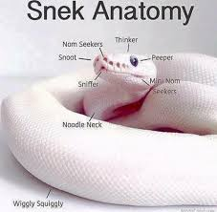

Slide 386
[record lecture]

Slide 387
LinkedList review

Slide 388
runtimes

Slide 389
worst case singly-linked list runtimes
head
list.add(index, value)
// O(n)
list.removeByIndex(index)
// O(n)
list.size()
// O(n)
list.addFront()
// O(1)
list.removeFront()
// O(1)
list.addBack()
// O(n)
list.removeBack()
// O(n)

Slide 390
additional warmup: prepending a list

Slide 391
example
Node snap = new Node(1.0);
Node crackle = new Node(2.0);
Node pop = new Node(3.0);
snap.next = crackle;
crackle.next = pop;
pop.next = head;
head = snap;
✍️
4.0
5.0
head

Slide 392
example
Node snap = new Node(1.0);
Node crackle = new Node(2.0);
Node pop = new Node(3.0);
snap.next = crackle;
crackle.next = pop;
pop.next = head;
head = snap;
4.0
5.0
head

Slide 393
example
Node snap = new Node(1.0);
Node crackle = new Node(2.0);
Node pop = new Node(3.0);
snap.next = crackle;
crackle.next = pop;
pop.next = head;
head = snap;
snap
1.0 | null
4.0
5.0
head

Slide 394
example
Node snap = new Node(1.0);
Node crackle = new Node(2.0);
Node pop = new Node(3.0);
snap.next = crackle;
crackle.next = pop;
pop.next = head;
head = snap;
snap
crackle
1.0 | null
2.0 | null
4.0
5.0
head

Slide 395
example
Node snap = new Node(1.0);
Node crackle = new Node(2.0);
Node pop = new Node(3.0);
snap.next = crackle;
crackle.next = pop;
pop.next = head;
head = snap;
snap
crackle
pop
1.0 | null
2.0 | null
3.0 | null
4.0
5.0
head

Slide 396
example
Node snap = new Node(1.0);
Node crackle = new Node(2.0);
Node pop = new Node(3.0);
snap.next = crackle;
crackle.next = pop;
pop.next = head;
head = snap;
snap
crackle
pop
1.0
2.0 | null
3.0 | null
4.0
5.0
head

Slide 397
example
Node snap = new Node(1.0);
Node crackle = new Node(2.0);
Node pop = new Node(3.0);
snap.next = crackle;
crackle.next = pop;
pop.next = head;
head = snap;
snap
crackle
pop
1.0
2.0
3.0 | null
4.0
5.0
head

Slide 398
example
Node snap = new Node(1.0);
Node crackle = new Node(2.0);
Node pop = new Node(3.0);
snap.next = crackle;
crackle.next = pop;
pop.next = head;
head = snap;
snap
crackle
pop
1.0
2.0
3.0
4.0
5.0
head

Slide 399
example
Node snap = new Node(1.0);
Node crackle = new Node(2.0);
Node pop = new Node(3.0);
snap.next = crackle;
crackle.next = pop;
pop.next = head;
head = snap;
snap
crackle
pop
1.0
2.0
3.0
4.0
5.0
head

Slide 400
example
Node snap = new Node(1.0);
Node crackle = new Node(2.0);
Node pop = new Node(3.0);
snap.next = crackle;
crackle.next = pop;
pop.next = head;
head = snap;
1.0
2.0
3.0
4.0
5.0
head

Slide 401
🧠 was that faster than calling addFront() n times? 🧠 same big O or different big O? (if we were to call it many times)
Node snap = new Node(1.0);
Node crackle = new Node(2.0);
Node pop = new Node(3.0);
snap.next = crackle;
crackle.next = pop;
pop.next = head;
head = snap;
addFront(3.0);
addFront(2.0);
addFront(1.0);
vs.

Slide 402
🧠 was that faster than calling addFront() n times? yes (only updated head once) 🧠 same big O or different big O? same (still have to "hook up" O(n) references)

Slide 403
[implement LinkedList]

Slide 404
[implement LinkedList]

Slide 405
size()

Slide 406
[ implement size() poorly ]

Slide 407
[ implement size() poorly ]

Slide 408
joyful implementation of size

Slide 409
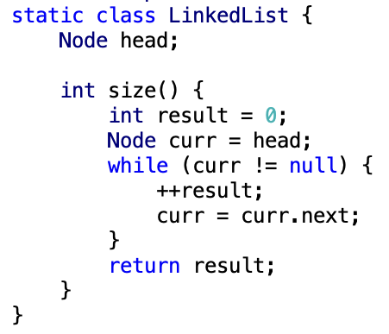

Slide 410
size()
what is the big O runtime of this method?
O(n) ☹️
this seems like a pretty steep cost to pay just to know the list’s size... what would be a more efficient approach?
store size as an instance variable
update it every time you change the number of elements in the list (inside of add, remove, etc.)
what is the runtime of this approach?
O(1) 🙂

Slide 411
while way more efficient, this approach is perhaps a bit spooky 👻 multiple functions are now also responsible for carefully modifying an instance variable (mess up, and any code that depends on size will be very weirdly broken)

Slide 412
note: the A homework doesn't use size at all

Slide 413
but if you were going to implement/use the list's size... i would start with size() as a function, get everything working perfectly, and only then carefully turn it into an instance variable 🙂👍

Slide 414

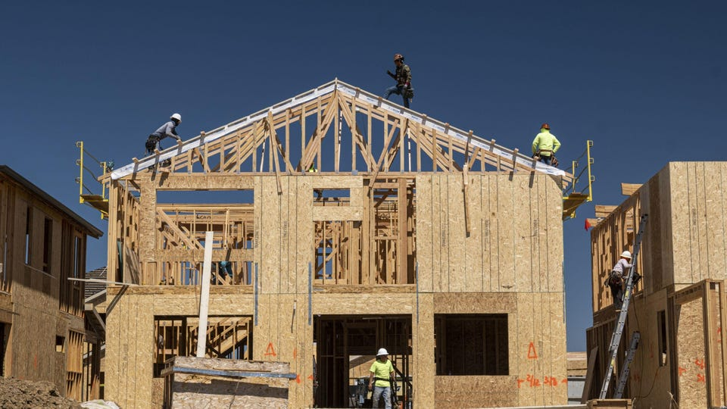
(it's this thing again)

Slide 415
tail reference

Slide 416
singly-linked list with reference to tail
head
tail
class LinkedList {
Node head;
Node tail;
}
class Node {
Value value;
Node next;
}

Slide 417
singly-linked list with reference to tail worst case runtimes
head
tail
list.add(index, value)
// O(n)
list.removeByIndex(index)
// O(n)
list.size()
// O(n)
list.addFront()
// O(1)
list.removeFront()
// O(1)
list.addBack()
// O(1) 😀
list.removeBack()
// O(n) 😡

Slide 418
doubly-linked list

Slide 419
singly- vs. doubly-linked

Slide 420
singly-linked list
head
class LinkedList {
Node head;
}
class Node {
Value value;
Node next;
}

Slide 421
doubly-linked list
tail
head
class LinkedList2 {
Node2 head;
Node2 tail;
}
class Node2 {
Value value;
Node2 next;
Node2 prev;
}

Slide 422
🤷
3.0
4.0
5.0

Slide 423
3.0
4.0
5.0

Slide 424
runtimes

Slide 425
worst case doubly-linked list runtimes
tail
head
list.add(index, value)
// O(n)
list.removeByIndex(index)
// O(n)
list.size()
// O(n)
list.addFront()
// O(1)
list.removeFront()
// O(1)
list.addBack()
// O(1) 😀
list.removeBack()
// O(1) 😀

Slide 426
a doubly-linked list is a great way to implement a deque (double-ended queue)
O(1) addFront() O(1) removeFront() O(1) addBack() O(1) removeBack()
🧠 could you pull this off with an array list?
no.
addFront() is O(n)
🧠 could you pull this off with an array?
sort of!—the array deque (amortized O(1) add)

Slide 427
Week08c
warmup: have you pre-registered? what classes are you taking?
🦜
underwater robotic spheres!
colloquium today in Wege (TCL123)
@ 2:30pm

Slide 428
pre-reg

Slide 429
237

Slide 430
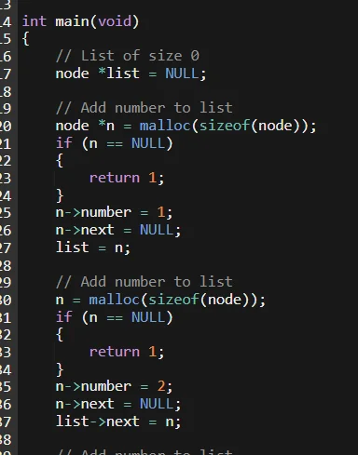

Slide 431
"the stack"
local variable primitives & references to Objects
undefined by default (will NOT compile if used)
"the heap"
the actual Objects (arrays and String's count as Objects)
cleared to 0 or null by default

Slide 433
LinkedList list =
new LinkedList("Hans -> Parrot");

Slide 434
LinkedList list;
{
Node node;
String string;
list = new LinkedList();
node = new Node();
string = "Hans";
node.value = string;
list.head = node;
node = new Node();
string = "Parrot";
node.value = string;
list.head.next = node;
}

Slide 435
LinkedList list;
{
Node node;
String string;
list = new LinkedList();
node = new Node();
string = "Hans";
node.value = string;
list.head = node;
node = new Node();
string = "Parrot";
node.value = string;
list.head.next = node;
}
list
UNDEFINED

Slide 436
LinkedList list;
{
Node node;
String string;
list = new LinkedList();
node = new Node();
string = "Hans";
node.value = string;
list.head = node;
node = new Node();
string = "Parrot";
node.value = string;
list.head.next = node;
}
list
node
UNDEFINED
UNDEFINED

Slide 437
LinkedList list;
{
Node node;
String string;
list = new LinkedList();
node = new Node();
string = "Hans";
node.value = string;
list.head = node;
node = new Node();
string = "Parrot";
node.value = string;
list.head.next = node;
}
list
node
string
UNDEFINED
UNDEFINED
UNDEFINED

Slide 438
LinkedList list;
{
Node node;
String string;
list = new LinkedList();
node = new Node();
string = "Hans";
node.value = string;
list.head = node;
node = new Node();
string = "Parrot";
node.value = string;
list.head.next = node;
}
list
node
string
0x11111111
UNDEFINED
UNDEFINED
null

Slide 439
LinkedList list;
{
Node node;
String string;
list = new LinkedList();
node = new Node();
string = "Hans";
node.value = string;
list.head = node;
node = new Node();
string = "Parrot";
node.value = string;
list.head.next = node;
}
list
node
string
0x11111111
0x22222222
UNDEFINED
null
null null

Slide 440
LinkedList list;
{
Node node;
String string;
list = new LinkedList();
node = new Node();
string = "Hans";
node.value = string;
list.head = node;
node = new Node();
string = "Parrot";
node.value = string;
list.head.next = node;
}
list
node
string
0x11111111
0x22222222
0x88888888
null
null null
H a n s

Slide 441
LinkedList list;
{
Node node;
String string;
list = new LinkedList();
node = new Node();
string = "Hans";
node.value = string;
list.head = node;
node = new Node();
string = "Parrot";
node.value = string;
list.head.next = node;
}
list
node
string
0x11111111
0x22222222
0x88888888
null
0x88888888 null
H a n s

Slide 442
LinkedList list;
{
Node node;
String string;
list = new LinkedList();
node = new Node();
string = "Hans";
node.value = string;
list.head = node;
node = new Node();
string = "Parrot";
node.value = string;
list.head.next = node;
}
list
node
string
0x11111111
0x22222222
0x88888888
0x22222222
0x88888888 null
H a n s

Slide 443
LinkedList list;
{
Node node;
String string;
list = new LinkedList();
node = new Node();
string = "Hans";
node.value = string;
list.head = node;
node = new Node();
string = "Parrot";
node.value = string;
list.head.next = node;
}
list
node
string
0x11111111
0x33333333
0x88888888
0x22222222
0x88888888 null
null null
H a n s

Slide 444
LinkedList list;
{
Node node;
String string;
list = new LinkedList();
node = new Node();
string = "Hans";
node.value = string;
list.head = node;
node = new Node();
string = "Parrot";
node.value = string;
list.head.next = node;
}
list
node
string
0x11111111
0x33333333
0x99999999
0x22222222
0x88888888 null
null null
H a n s
P a r r o t

Slide 445
LinkedList list;
{
Node node;
String string;
list = new LinkedList();
node = new Node();
string = "Hans";
node.value = string;
list.head = node;
node = new Node();
string = "Parrot";
node.value = string;
list.head.next = node;
}
list
node
string
0x11111111
0x33333333
0x99999999
0x22222222
0x88888888 null
0x99999999 null
H a n s
P a r r o t

Slide 446
LinkedList list;
{
Node node;
String string;
list = new LinkedList();
node = new Node();
string = "Hans";
node.value = string;
list.head = node;
node = new Node();
string = "Parrot";
node.value = string;
list.head.next = node;
}
list
node
string
0x11111111
0x33333333
0x99999999
0x22222222
0x88888888 0x33333333
0x99999999 null
H a n s
P a r r o t

Slide 447
LinkedList list;
{
Node node;
String string;
list = new LinkedList();
node = new Node();
string = "Hans";
node.value = string;
list.head = node;
node = new Node();
string = "Parrot";
node.value = string;
list.head.next = node;
}
list
0x11111111
0x22222222
0x88888888 0x33333333
0x99999999 null
H a n s
P a r r o t

Slide 448
LinkedList list;
{
Node node;
String string;
list = new LinkedList();
node = new Node();
string = "Hans";
node.value = string;
list.head = node;
node = new Node();
string = "Parrot";
node.value = string;
list.head.next = node;
}
list
0x11111111
0x22222222
0x88888888 0x33333333
0x99999999 null
H a n s
P a r r o t

Slide 449
memory in C

Slide 450
in C, we often get to choose whether to allocate memory on the stack or the heap

Slide 451
memory allocation
// Java
int[] heapAllocatedArray = new int[10]
heapAllocatedArray[0] = 3;
// C
int stackAllocatedArray[10];
int *heapAllocatedArray = malloc(10000000 * sizeof(int));
stackAllocatedArray[0] = 3;
heapAllocatedArray[0] = 3;
free(heapAllocatedArray);

Slide 452
256

Slide 453
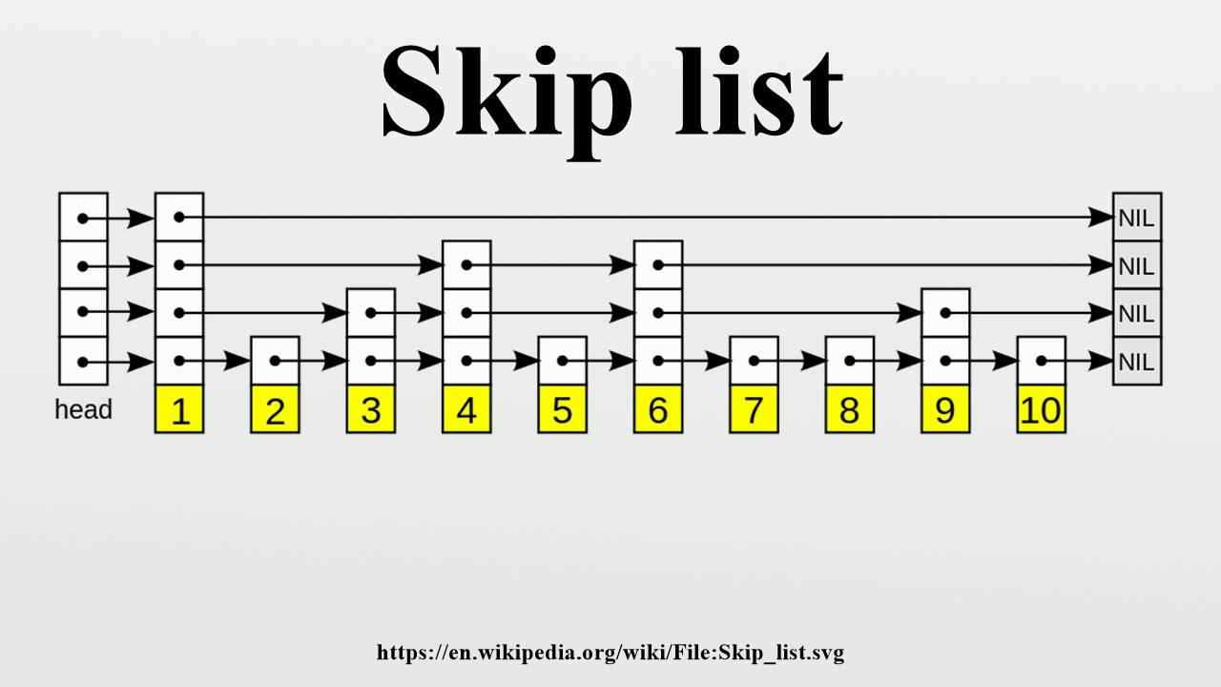

Slide 454
334

Slide 455
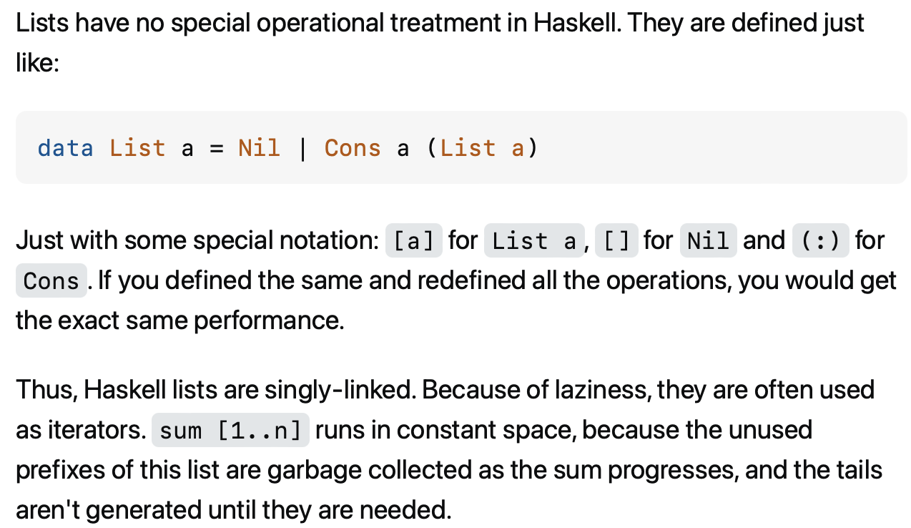

Slide 456
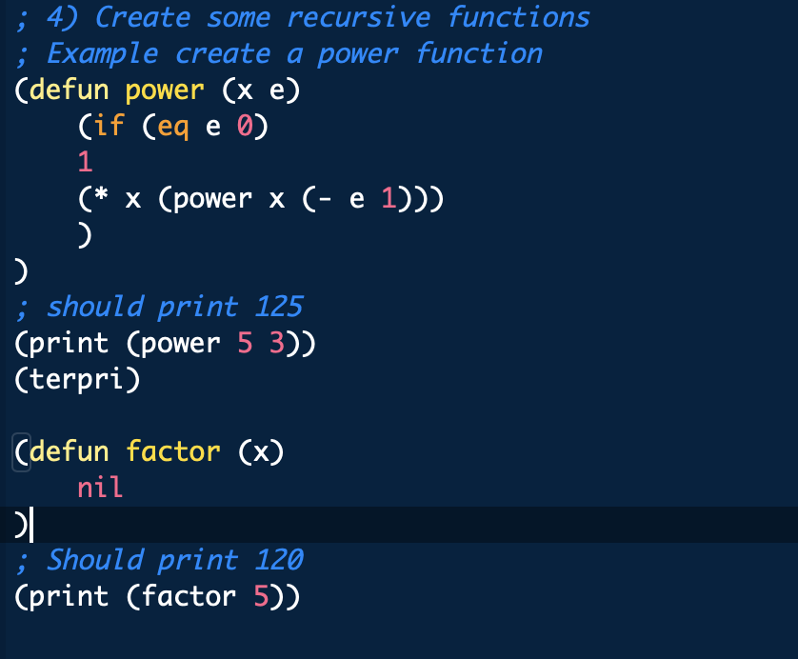

Slide 457
something fun?

Slide 458
fun friday menu - jim rants about comments and syntax highlighting - jim continues codeing (some of) microsoft paint from scratch - jim updates you on his CAD software - jim show and tells about his favorite element - jim reads aloud from grugbrain.dev - jim reads aloud from vim creep - jim reads aloud from hexing the technical interview - jim reads aloud from the truth about lisp - jim reads aloud from the worst API ever made

Slide 459
midterm

Slide 460
common areas of struggle

Slide 461
question 1
syntax
list.add(int 3); // void add(int element);
True
}

Slide 462
}
generally speaking {
you want your curly braces {
}
to look {
something like this {
}
}
}

Slide 463
}
generally speaking
{
you want your curly braces
{
}
to look
{
something like this
{
}
}
}

Slide 464
}
this is quite spooky {
and hard {
to read }
it's hard to tell {
where one scope starts {
and the next ends
}}
do i have enough braces?

Slide 465
question 3
control flow
returning too early (inside for loop)
handling special case too late (after creating array)
if...if vs. if...else if vs. if...else
syntax
list[i]
null
boolean 7Found;
;

Slide 466
question 5
complete understanding of app
pool
single enemy vs. multiple enemies

Slide 467
question 6
complete understanding of app
buffer is 8 characters long, but only length many characters are drawn
last question

Slide 468
results

Slide 469
summay
distribution is very wide (this is normal)
some grades are low (< ~50)
this does not mean you will fail the coure
"if you do all the homework, and the exams just aren't working for you, you will pass CS136" – James Bern, Fri Nov 1
my comments are very sparse
if you don't know why you lost points, or you think i may have made a mistake please ask

Slide 470
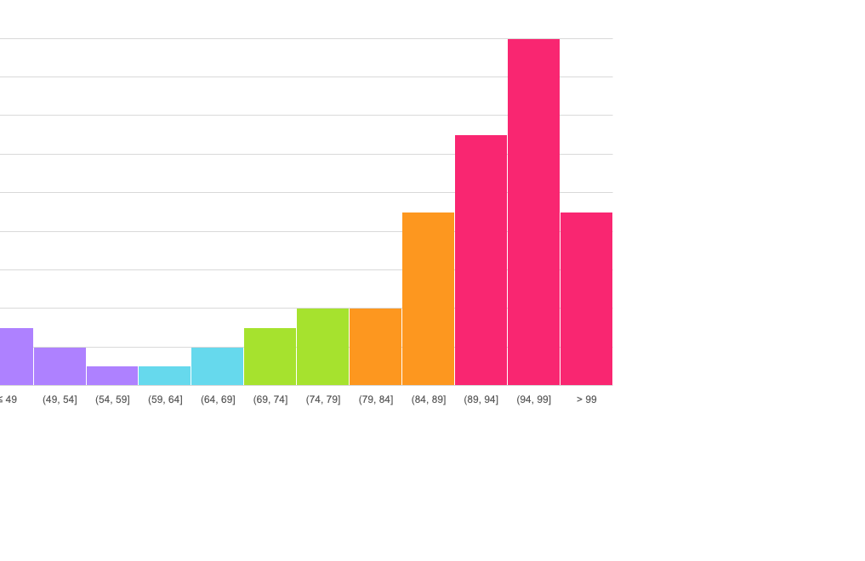
mean: 86.4
standard deviation: 15.9

Slide 471
thoughts

Slide 472
Week09a
✨No Laptop Monday Funday! ✨
🦜🦜🦜
🦜🦜🦜
🦜🦜🦜
directed graph preview
trees
BOTANY WARMUP
what is a tree?
what is a branch?
what is a node?
ADDITIONAL WARMUP
what does binary mean?
what is a binary tree?
what does ternary mean?
[record lecture]

Slide 473
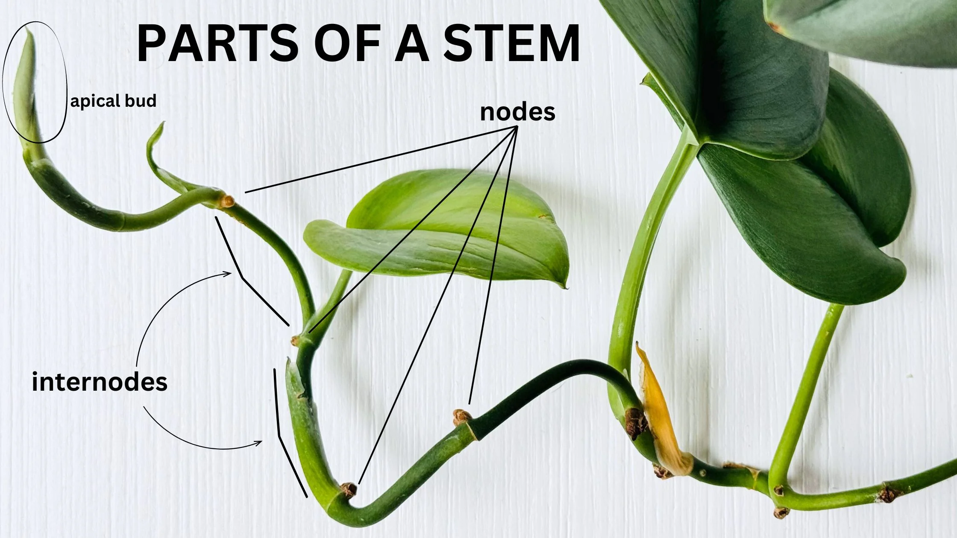

Slide 474
directed graphs

Slide 475
quick note: Math vs. CS

Slide 476
CS vs. Math
a directed graph is a data structure
it has nodes that refer to any number of other nodes
a directed graph G = (V, E) is also a mathematical object
it has vertices (nodes) V
it has directed edges E
note: E is a set of 2-tuples

Slide 477
these are really just two different ways of looking at the same thing

Slide 478
both are useful! (Math to figure out the algorithm, CS to code it up)

Slide 479
in CSCI 136, i will focus on the CS view (MATH 200, CSCI 256 will look at the Math side)

Slide 480
🙂👍

Slide 481
directed graph

Slide 482
the directed graph generalizes the linked list
a node in a directed graph has references to any number of other nodes
nodes are drawn as circles
references are drawn as arrows
let's not worry about
whether this is allowed
or whether this is allowed

Slide 483
(whether we allow for self-edges, multiple edges, etc. depends on context)

Slide 484
🙂👍

Slide 485
tree

Slide 486
kinship terminology (parent, child, etc.)

Slide 487
kinship terminology is useful for describing trees
a node has references to other nodes
it is their parent
they are its children

Slide 488
(directed) tree

Slide 489
a (directed) tree is a directed graph that...
has exactly one node with zero parents (the root)
has no nodes with more than one parent
has no cycles (loops) of any kind
is connected (just one tree, not multiple disconnected trees)
(otherwise, it would be a forest)
5
16
2
2
2
13
18
1
4
11
15
19

Slide 490
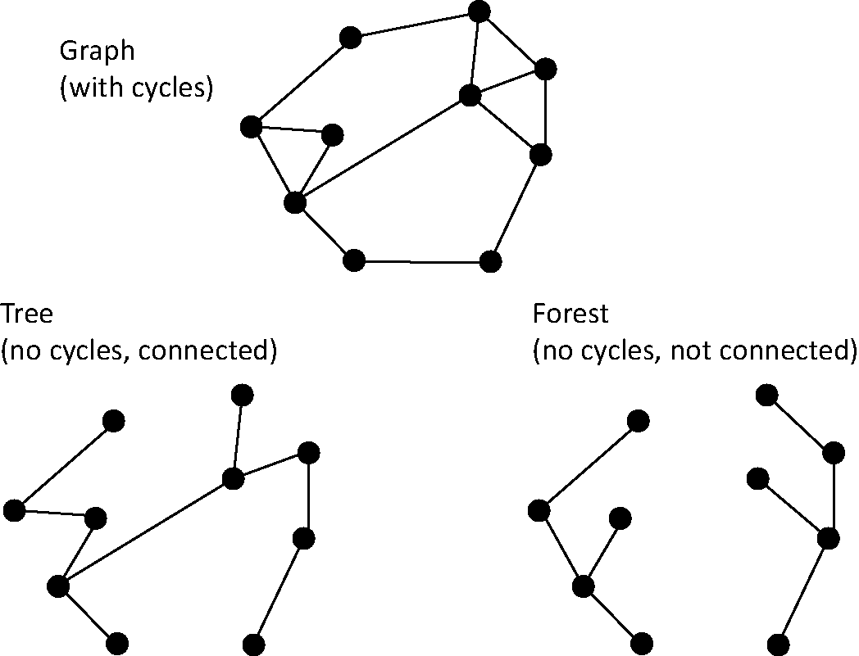
note: not joking

Slide 491
Monday Funday

Slide 492
time for everyone's favorite home game...

Slide 493
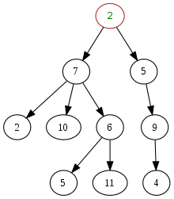
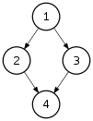
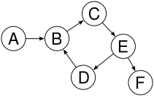
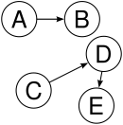

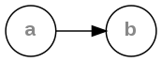
is it a tree?
yes
no
violates 2 & 3
tree rules
exactly one node with zero parents
no node with more than one parent
no cycles
is connected
no
violates 2 & 3
no
violates 1 & 4
no
violates 1 & 3
yes

Slide 494
is it a tree?
yes

Slide 495

can be seen as

Slide 496
uses of trees

Slide 497
simplifying expressions

Slide 498
(2 + 3)
* 4
*
+
4
2
3

Slide 499
5
* 4
*
5
4

Slide 500
20
20

Slide 501
!
(true && )
(false || true)
!
&&
true
||
false
true

Slide 502
!
(true && true)
!
&&
true
true

Slide 503
!true
!
true

Slide 504
false
false

Slide 505
and so much more!

Slide 506
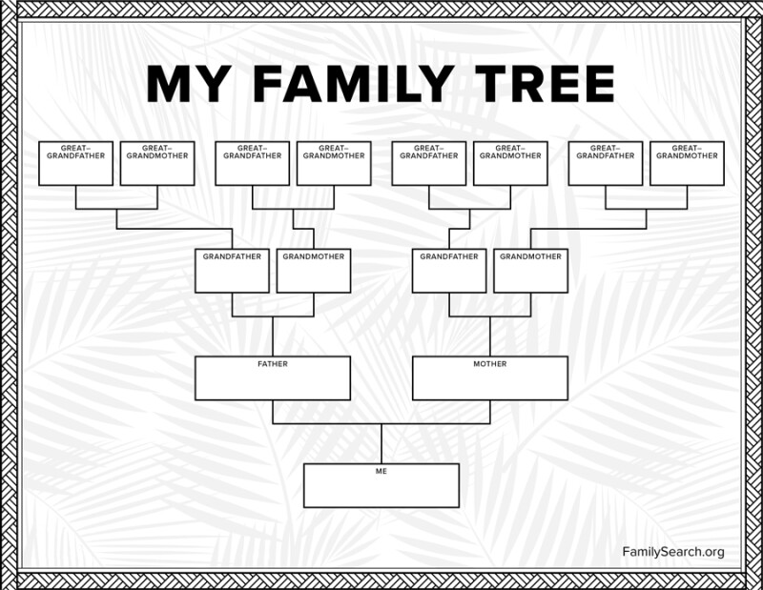

Slide 507
careful: these nodes are
the children of
the node with value jim
jim
jim's mom
jim's dad
jim's mom's mom
jim's mom's dad
jim's dad's mom
jim's dad's dad

Slide 508
note: family trees considered deeply confusing; let us never talk of them again 🙅

Slide 509
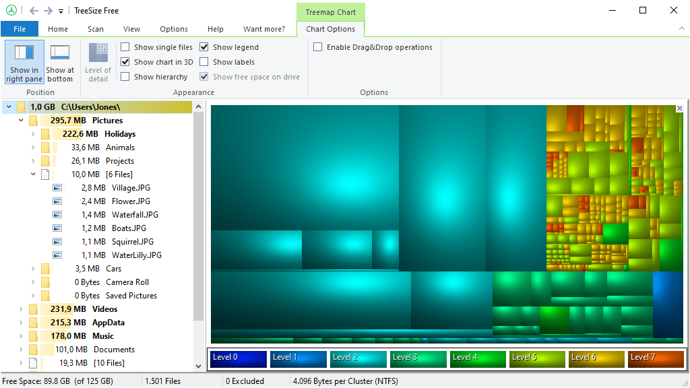
File System (TreeSize Free)
https://www.jam-software.com/treesize_free

Slide 510
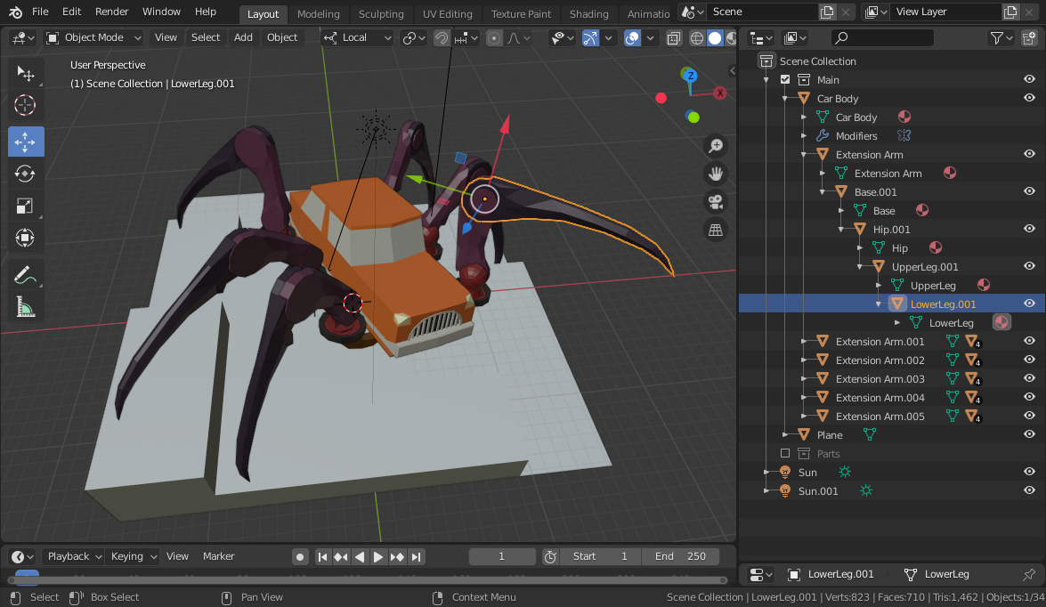
Transformation Hierarchy (Blender)
https://15466.courses.cs.cmu.edu/lesson/hierarchy

Slide 511
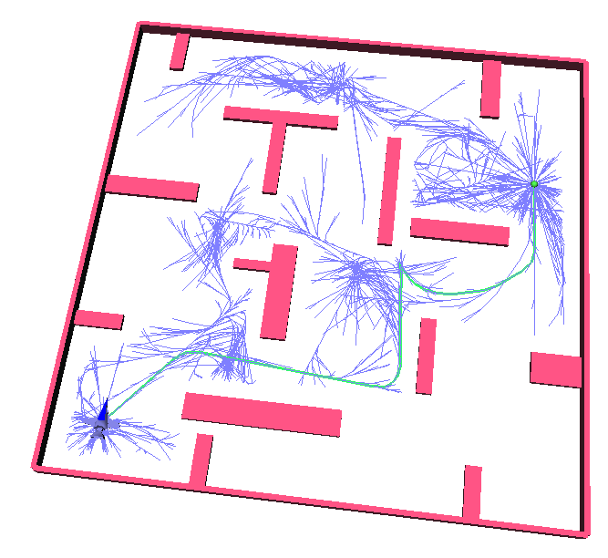
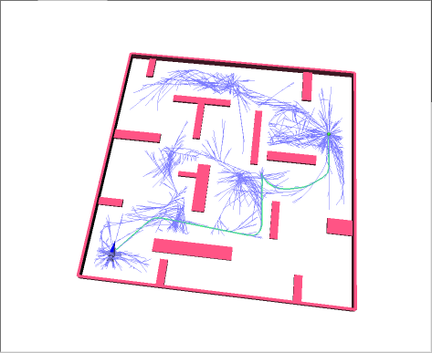
Rapidly Exploring Random Trees (RRTs)
Randomized Kinodynamic Planning by Steven M. LaValle and James J. Kuffner, Jr., International Journal of Robotics Research, 20(5):378--400, May 2001

Slide 512
Hierplane (Mark)

Slide 513
[homework preview]

Slide 514
different ways to implement trees

Slide 515
ArrayList<Node> children; Node leftChild; Node rightChild; Node[] children;

Slide 516
Week09b
✨Laptop Wednesday! ✨
for-each loop
tree terminology
terrific tree traversal tutorial
BONUS WARMUP
evaluate this expression tree
🦜🦜🦜
🦜🦜🦜
🦜🦜🦜
WARMUP
what does depth mean?
what does breadth mean?
what does first mean?

Slide 517
[address the election?]

Slide 518
[record lecture]

Slide 519
☠️ for-each loop

Slide 520
☠️ for-each loop

Slide 521
🐍 Python's for loop is a for-each loop
lst = [ True, 5.0, "Hello" ]
for element in lst: # for each item in the list...
print(element)

Slide 522
a for-each loop can be a convenient alternative to a for loop
for (int turretIndex = 0; turretIndex < turrets.length; ++turretIndex) {
Turret turret = turrets[turretIndex];
...
}
for (Turret turret : turrets) { // for each turret in turrets...
...
}

Slide 523
a for-each loop can be a convenient alternative to a for loop
for (int strokeIndex = 0; strokeIndex < currentFrame.size(); ++strokeIndex) {
ArrayList<Point> stroke = currentFrame.get(strokeIndex);
for (int pointIndex = 0; pointIndex < stroke.size(); ++pointIndex) {
Point point = stroke.get(pointIndex);
...
}
}
for (ArrayList<Point> stroke : currentFrame) {
for (Point point : stroke) {
...
}
}
forgive me 🥲
i swear all that indexing built character

Slide 524
for-each can be convenient but...

Slide 525
you never *need* a for-each loop (some languages don't even have one)

Slide 526
☠️ for-each loops can get you into trouble if you don't fully understand how references and Objects work in Java

Slide 527
☠️ for-each loop dangers
☠ a for-each loop provides a "convenient reference"
☠ LESS powerful than a regular for loop
for (int i = 0; i < things.length; ++i) {
Thing thing = things[i]; // thing is a "convenient reference"
...
}
for (Thing thing : things) { // thing is a "convenient reference"
...
}

Slide 528
☠️ for-each loop dangers
for (int i = 0; i < things.length; ++i) {
things[i] = new Thing(); // does write to array 🙂👍
}
for (int i = 0; i < things.length; ++i) {
Thing thing = things[i]; // thing is a "convenient reference"
thing = new Thing(); // does NOT write to array
}
for (Thing thing : things) { // thing is a "convenient reference"
thing = new Thing(); // does NOT write to array
}

Slide 529
☠️ for-each loop for iterating over a String
in Java, a for-each loop can iterate through String's with toCharArray()
☠ toCharArray() is O(n), but fine for CSCI 136
for (char c : string.toCharArray()) {
...
}

Slide 530
more tree terminology

Slide 531
more tree terminology

Slide 532


Slide 534
the root has no parents a leaf has no children
root
5
16
2
13
18
leaves

Slide 535
a path is a chain of distinct edges
16
path
13
18

Slide 536
a node's depth is the number of edges in the path from the root to that node
depth 0
5
16
depth 1
2
13
18
depth 2
depth 3

Slide 537
level means either depth or (depth + 1) depending on who you ask 🤷‍♀️

Slide 538
tree traversal

Slide 539
breadth-first vs. depth-first

Slide 540

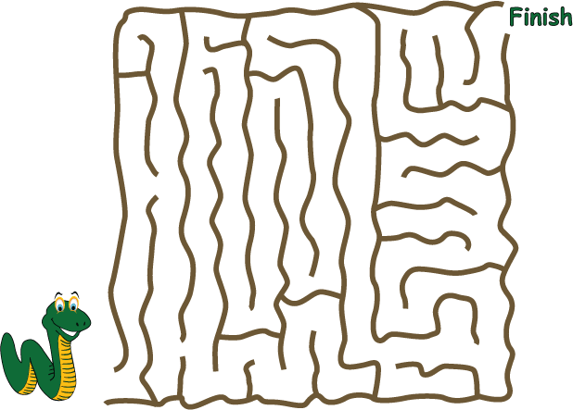
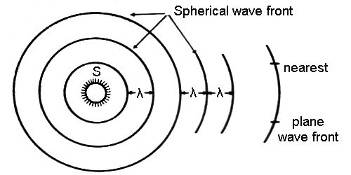
breadth-first vs. (pre-order) depth-first
"a persistent, optimistic, very thorough worm" –Mark Hopkins

Slide 541
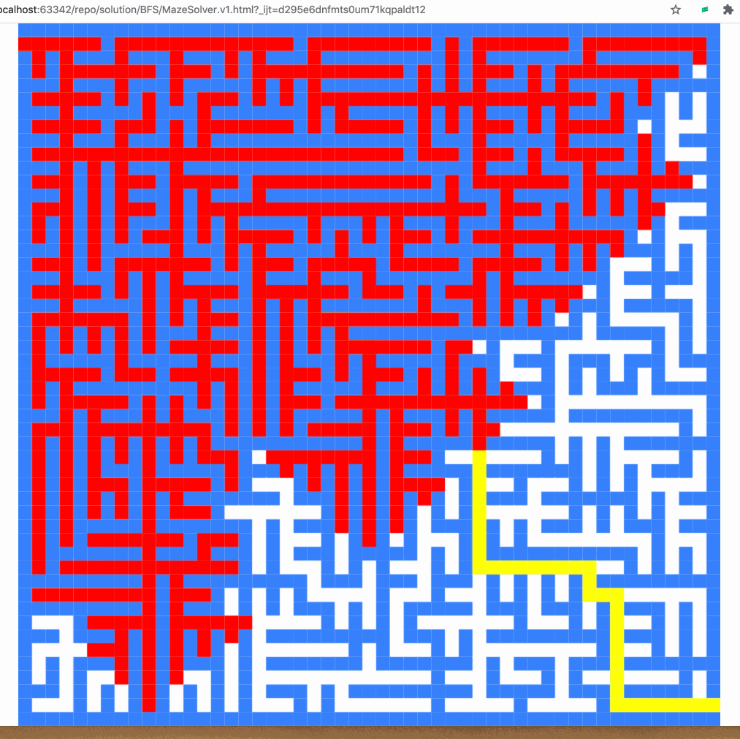
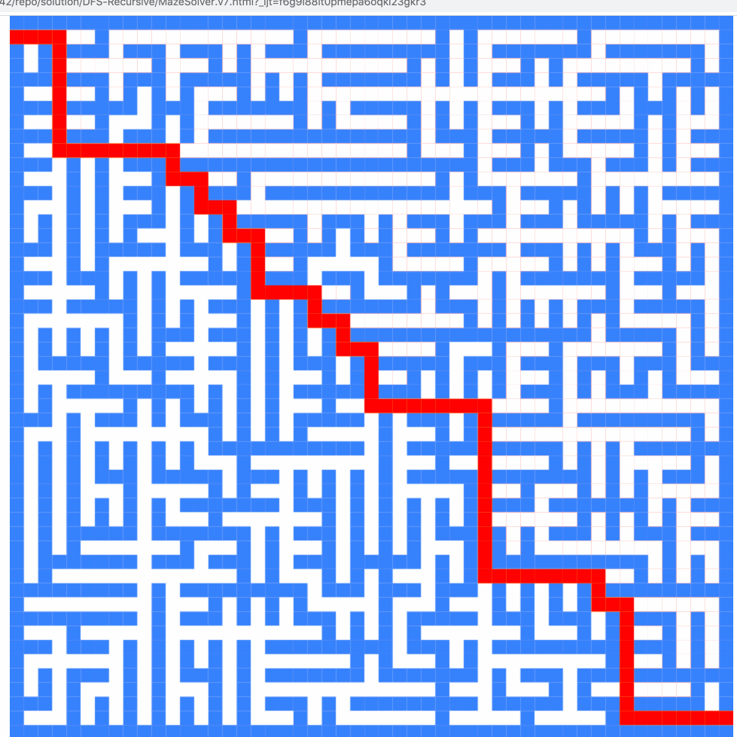
breadth-first vs. (pre-order) depth-first

Slide 542
breadth-first vs. (pre-order) depth-first
0
0
1
2
3
1
2
3
4
5
4
5
6
6
0
1
2
3
4
5
6
0
1
4
6
5
2
3

Slide 543
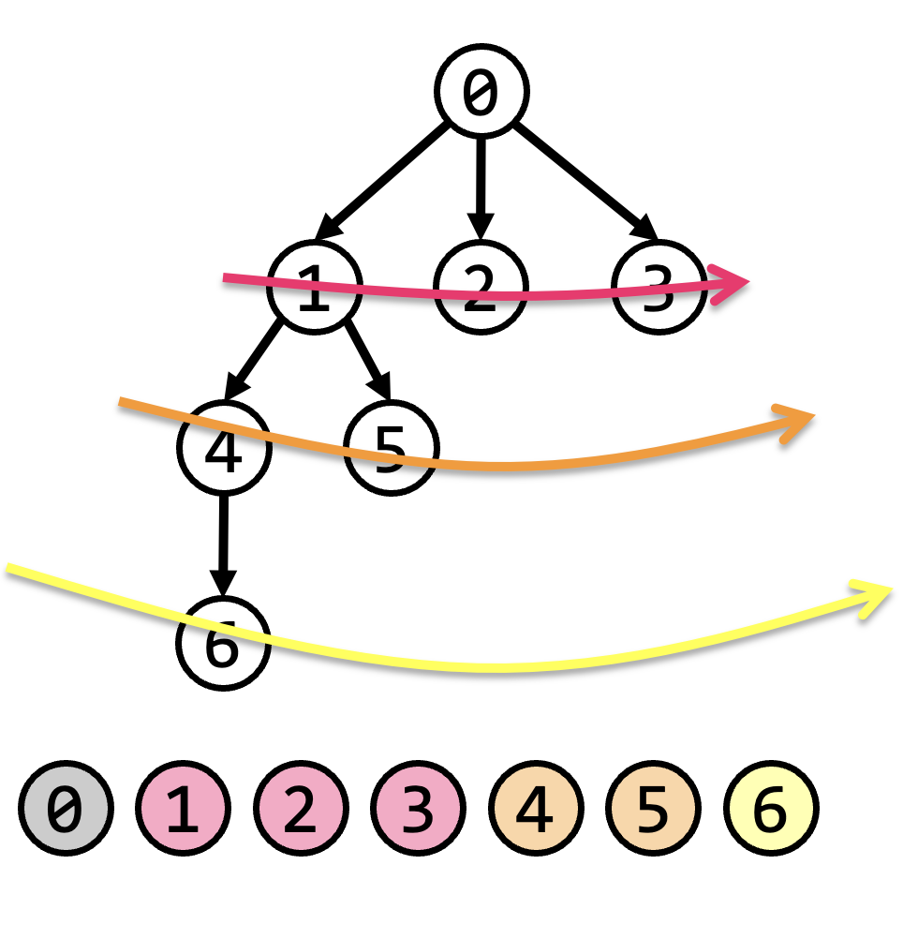
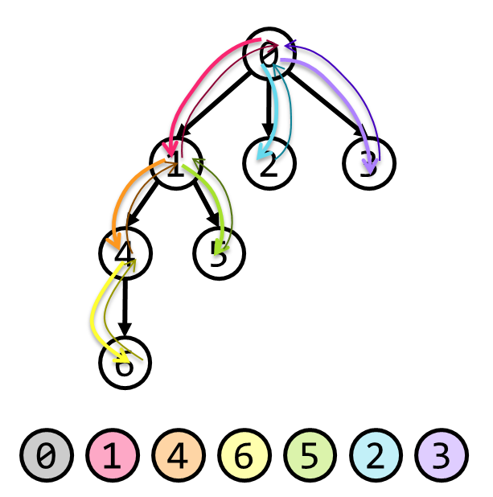
tree traversal (walking the tree)
tree traversal means iterating through all of the tree's nodes
breadth-first first explores as broadly (widely) as possible
one level (depth) at a time
uses a queue
depth-first first explores as deeply as possible
one root-to-leaf path at a time
uses a stack (or recursion, which uses the callstack)
☠ there are actually many different variants of depth-first traversal (i will explain them when we get to binary trees)

Slide 544
why might we want to traverse a tree? why did we want to traverse a linked list? do we ever *traverse* an array?

Slide 545
gathering all words in a trie (HW09)
searching for something (HW10?)
evaluating an expression tree
gathering all the nodes into a list (Tut09)

Slide 546
Terrific Tree Traversal Tutorial

Slide 547
explanation

Slide 548
Week09c
Friday.
trees vs. graphs
WARMUP
have you ever played the game Worms World Party?
how would you implement it?

Slide 549
[record lecture]

Slide 550
Terrific Tree Traversal Tutorial treview

Slide 551
traverseBreadthFirst
change color to indicate
hasBeenVisited = true
0 added to queue
0 removed from queue
1 added to queue
2 added to queue
3 added to queue
1 removed from queue
4 added to queue
5 added to queue
2 removed from queue
3 removed from queue
6 added to queue
4 removed from queue
5 removed from queue
6 removed from queue
7 added to queue
7 removed from queue
0
1
2
3
4
5
6
queue.add(root)
while queue not empty:
curr = queue.remove()
... # process curr
for child in curr.children:
queue.add(child)
7
0
1
2
3
4
5
6
7

Slide 552
traversePreOrderDepthFirst
change color to indicate
hasBeenVisited = true
start recurse(0)
start recurse(1)
start recurse(4)
finish recurse(4)
start recurse(5)
finish recurse(5)
finish recurse(1)
start recurse(2)
finish recurse(2)
start recurse(3)
start recurse(6)
start recurse(7)
finish recurse(7)
finish recurse(6)
finish recurse(3)
finish recurse(0)
0
1
2
3
4
5
6
def recurse(curr):
... # process curr
for child in curr.children:
recurse(child)
7
recurse(root)
0
1
4
5
2
3
6
7

Slide 553
example: two a-maze-ing mazes

Slide 554
maze A

Slide 555


start
finish

Slide 587
maze B

Slide 588
start
finish

Slide 589
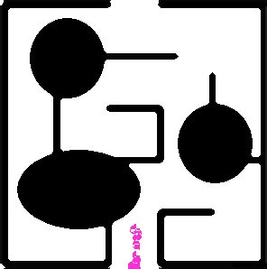

Slide 591
[worms world party]

Slide 592
trees vs. graphs

Slide 593
the problem with naively traversing a graph

Slide 594
directed cycles (loops) in the graph will create infinite loops in your code

Slide 595
[example (live coding)]
0
1
2
3

Slide 596
how to traverse a graph

Slide 597
to traverse a graph, you need to keep track of which nodes you have visited
Option A: Store a boolean called hasBeenVisited on each Node.
Option B: Use another data structure to keep track of visited nodes.
for example, HashMap<Node, Boolean> hasNodeBeenVisited;
or even better (smaller), HashSet<Node> visitedNodes;

Slide 598
example: traversing a graph with a directed cycle
1
2
3

Slide 599
example: flood fill 🪣

Slide 600
quadtree rabbit hole 🐰

Slide 601
problem: naive collision detection is slow O(n^2) to check all pairs

Slide 602
idea: use a grid O(n) to assign all circles to grid cells

Slide 603
problem: so many grid cells; most empty!

Slide 604
idea: "only have grid where you need it"

Slide 605
problem: how do we store this?

Slide 606
idea: a tree

Slide 607
idea: a tree

Slide 608
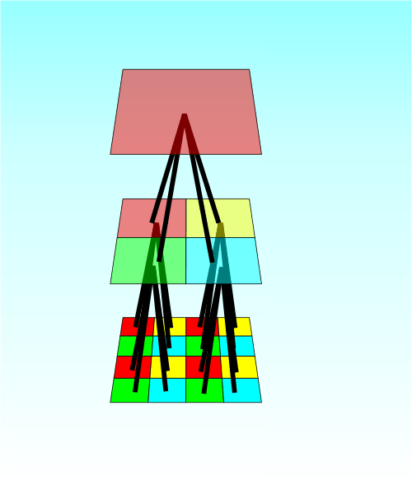

Slide 609
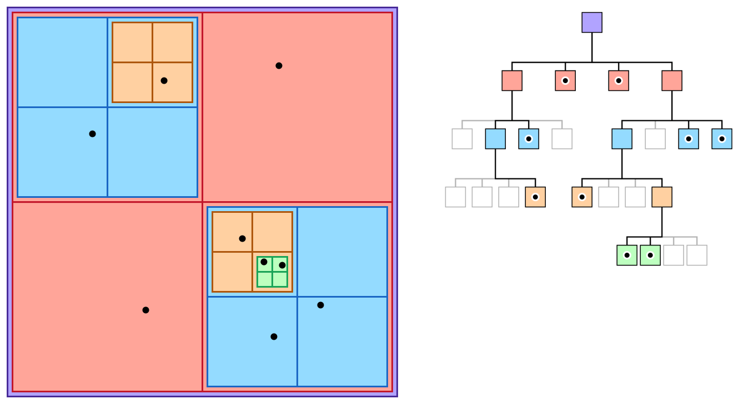

Slide 610
quadtree reading

